Slide 1
Hypothesis Test for
Two Proportions

Slide 2
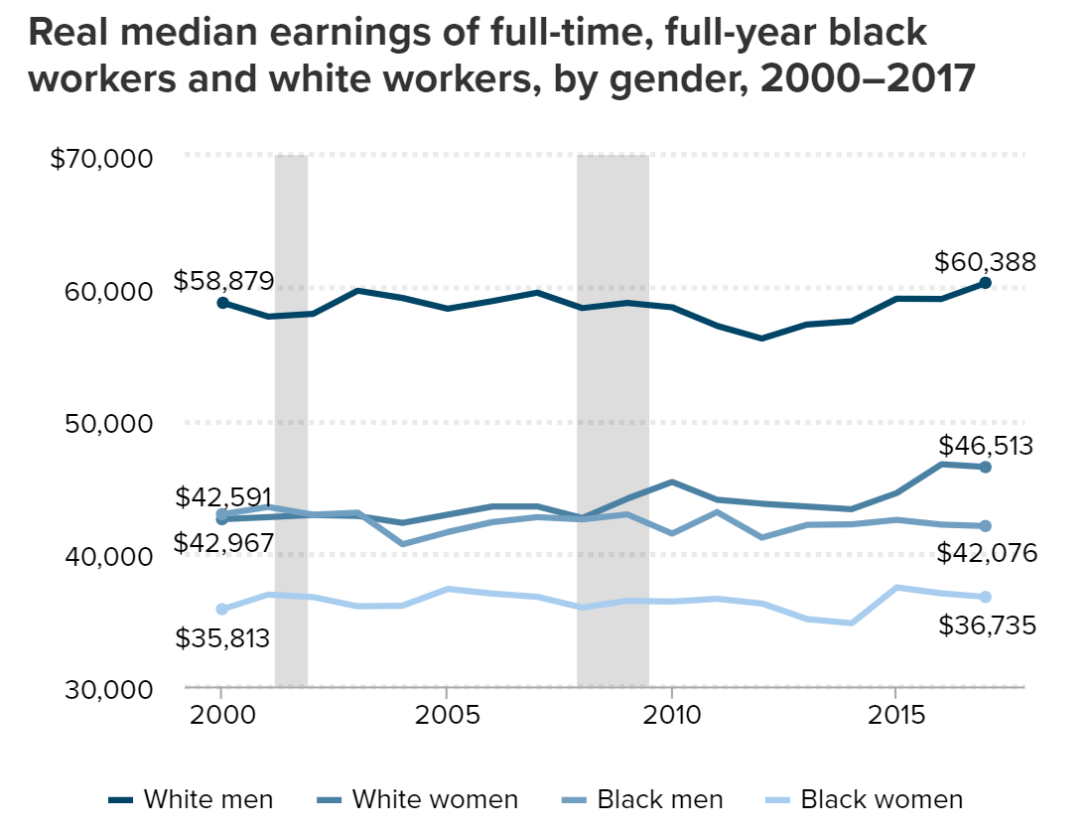
Hiring discrimination
Researchers wanted to test if hiring discrimination was a factor in labor markets
Economic Policy Institute, 2018: https://www.epi.org/blog/black-workers-have-made-no-progress-in-closing-earnings-gaps-with-white-men-since-2000/

Slide 3
Note
This lesson presents a slightly simplified version of their study design. However, the data in the lesson is identical to the real study data. See citation below for their full paper:
Bertrand, Marianne and Sendhil Mullainathan. "Are Emily And Greg More Employable Than Lakisha And Jamal? A Field Experiment On Labor Market Discrimination," American Economic Review, 2004, v94(4,Sep), 991-1013. https://www.nber.org/papers/w9873

Slide 4
The Race/Resumé Study
Resumé
Greg Baker
University of Massachusetts, Lowell
Major: Business, GPA: 3.5
Experience
Sales Consultant, Summer 2011
___________________________________________________________________________
Development Intern, Spring 2010
_________________________________________________________________________________________________
Resumé
Jamal Jones
University of Massachusetts, Lowell
Major: Business, GPA: 3.5
Experience
Sales Consultant, Summer 2011
___________________________________________________________________________
Development Intern, Spring 2010
_________________________________________________________________________________________________
Greg Baker
Jamal Jones
Note: These names were used as the main example in the original study paper.

Slide 5
The jobs
Wide swath of jobs in the following industries: sales, administrative support, clerical services, and customer services
Large range of positions, from “cashier work at retail establishments and clerical work in a mailroom to office and sales management positions.”

Slide 6

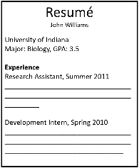
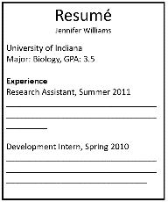
The Race/Resumé Study
n = 4890
employers
Greg
Jamal

Slide 7
The Race/Resumé Study
Measured which group got more callbacks from potential employers
Greg
Jamal
n₁ = 2445
n₂ = 2445

Slide 8


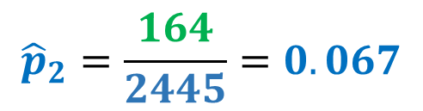
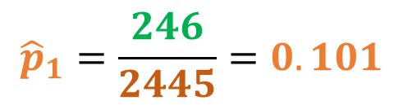
The results
Treatment 1
Treatment 2
 | Commonly-White Names | Commonly-Black Names | Total
Called back | 246 | 164 | 410
Not called back | 2199 | 2281 | 4480
Total | 2445 | 2445 | 4890
Comparing the proportion who received callbacks from both treatments.
$$n_{1}=2445$$
$$n_{2}=2445$$
$${\hat{p}}_{1}=\frac{246}{2445}=0.101$$
$${\hat{p}}_{2}=\frac{164}{2445}=0.067$$

Slide 9
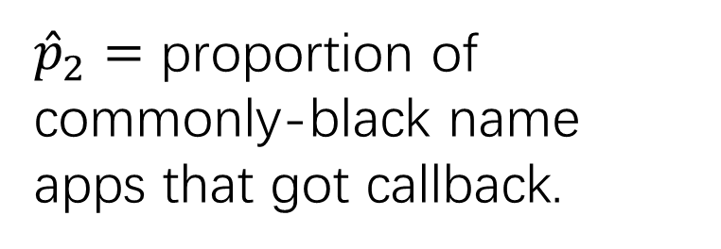
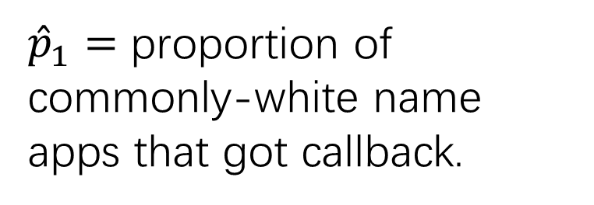
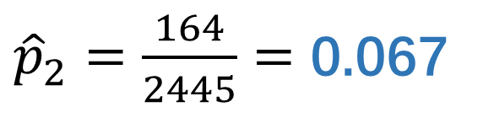
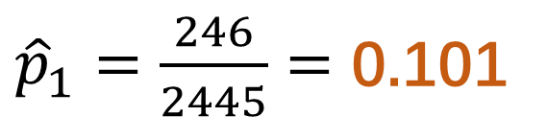

Two-Sample Situation
If there’s hiring discrimination, ${\hat{p}}_{1}>{\hat{p}}_{2}$
Group 1: White
Group 2: Black
${\hat{p}}_{1}=$ proportion of commonly-white name apps that got callback.
>
${\hat{p}}_{2}=$ proportion of commonly-black name apps that got callback.
>
${\hat{p}}_{1}=\frac{246}{2445}=$ 0.101
${\hat{p}}_{2}=\frac{164}{2445}=$ 0.067
Are these proportions different enough to show discrimination, or could this difference have been a result of chance alone?

Slide 10
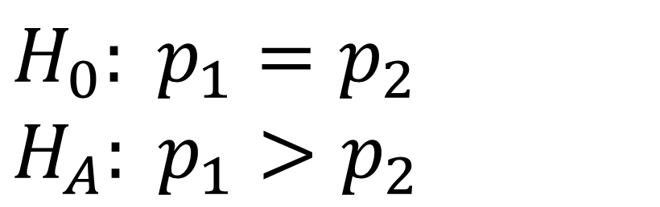
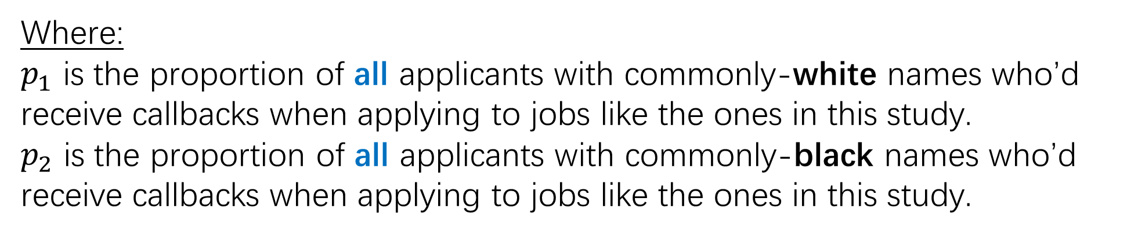
Hypotheses
There is no discrimination, so the callback rate is the same in both groups. You’re seeing if there’s evidence to reject this default claim.
$$H_{0}: p_{1}=p_{2}$$
$H_{A}: p_{1}>p_{2}$
There is discrimination, in which case the commonly-white named applications received a higher rate of callbacks.
Where:
$p_{1}$ is the proportion of all applicants with commonly-white names who’d receive callbacks when applying to jobs like the ones in this study.
$p_{2}$ is the proportion of all applicants with commonly-black names who’d receive callbacks when applying to jobs like the ones in this study.

Slide 11
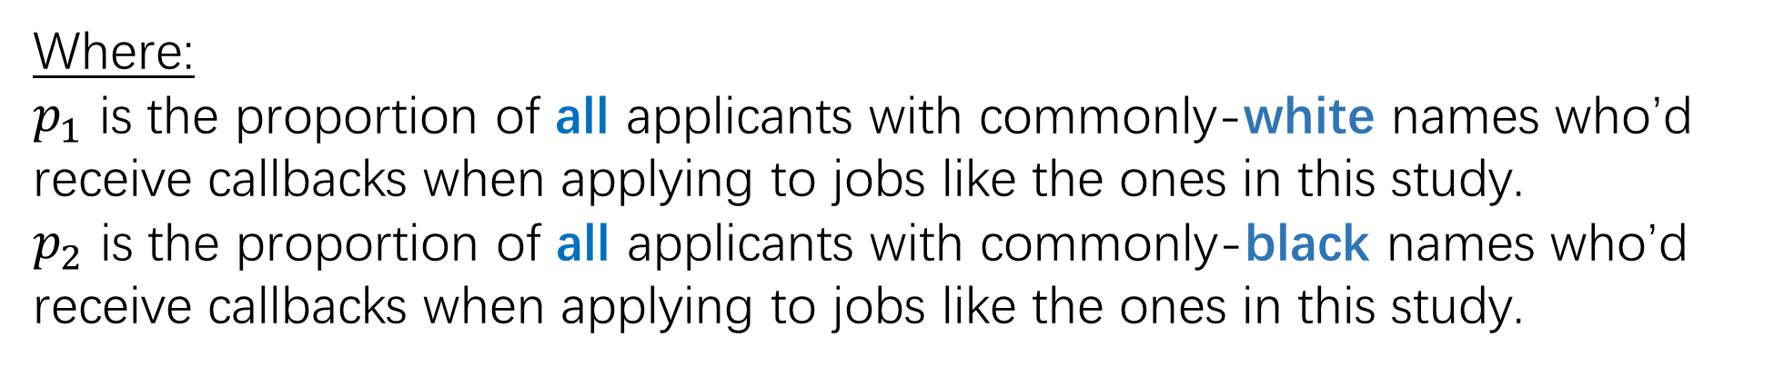
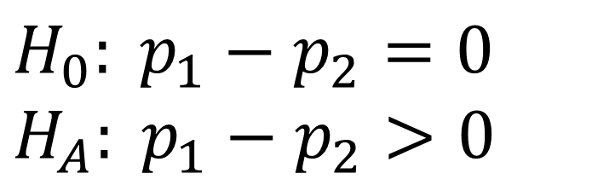

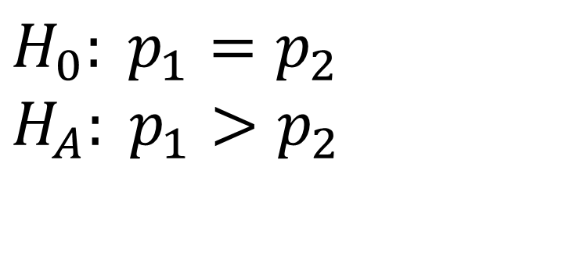
Setting up the Hypotheses
$$H_{0}: p_{1}=p_{2}$$
$$H_{A}: p_{1}>p_{2}$$
$H_{0}: p_{1}−p_{2}=0$
$H_{A}: p_{1}−p_{2}>0$
$$OR$$
Where:
$p_{1}$ is the proportion of all applicants with commonly-white names who’d receive callbacks when applying to jobs like the ones in this study.
$p_{2}$ is the proportion of all applicants with commonly-black names who’d receive callbacks when applying to jobs like the ones in this study.

Slide 12


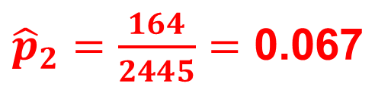
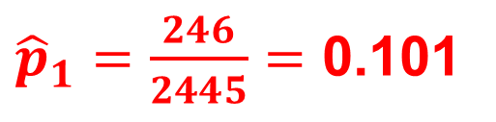
Calculations
Since null assumes $p_{1}$= $p_{2}$, so we can combine the proportion who got callbacks into one estimate: ${\hat{p}}_{c}$
Under certain conditions:
${\hat{p}}_{1}\text{− }{\hat{p}}_{2}$ ~ N$(μ=0, σ=\sqrt{\frac{{\hat{p}}_{c} (1−{\hat{p}}_{c})}{n_{1}}+\frac{{\hat{p}}_{c} (1−{\hat{p}}_{c})}{n_{2}}})$
${\hat{p}}_{1}=\frac{246}{2445}=$ 0.101
Centered at zero (since null assumes no difference between callback rates)
${\hat{p}}_{2}=\frac{164}{2445}=$ 0.067
Combined proportion ${\hat{p}}_{c}=\frac{246+164}{2445+2445}=$ 0.084

Slide 13
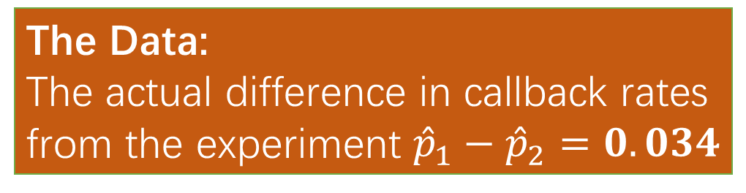
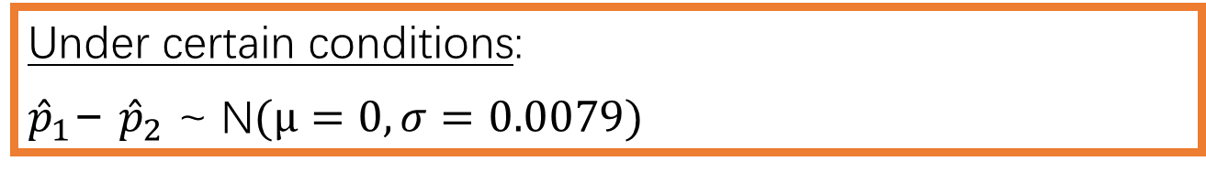
Calculations
Since null assumes $p_{1}$= $p_{2}$, so we can combine the proportion who got callbacks into one estimate: ${\hat{p}}_{c}$
The Data:
The actual difference in callback rates from the experiment ${\hat{p}}_{1}−{\hat{p}}_{2}=0.034$
Under certain conditions:
${\hat{p}}_{1}\text{− }{\hat{p}}_{2}$ ~ N$(μ=0, σ=0.0079)$
How unlikely was our data?
${\hat{p}}_{1}=\frac{246}{2445}=$ 0.101
Centered at zero (since null assumes no difference between callback rates)
Check the p-value!
${\hat{p}}_{2}=\frac{164}{2445}=$ 0.067
Combined proportion ${\hat{p}}_{c}=\frac{246+164}{2445+2445}=$ 0.084

Slide 14
Conclusion
Under my assumption that there is no difference in callback rates, the actually observed data (a 3.4% difference in callback rates among 4890 employers) is highly unlikely (p-value = 0.00001 < alpha level of 0.05). So, I reject my earlier assumption. There’s convincing evidence that commonly-white named resumés receive a higher callback rate.

Slide 15
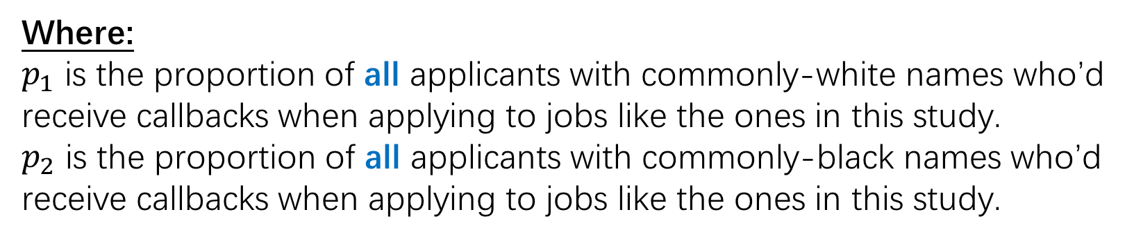
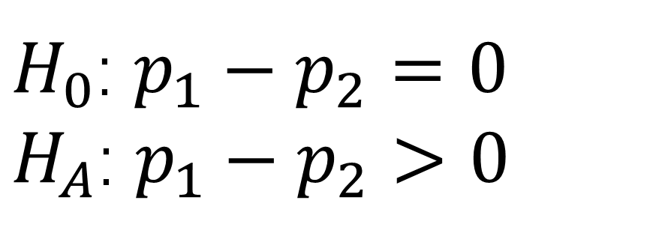
State-Plan-Do-Conclude
State: State the hypotheses, significance level, and define your parameters
$H_{0}$: $p_{1}−p_{2}=0$
$H_{A}$: $p_{1}−p_{2}>0$
α = 0.05
Where:
$p_{1}$ is the proportion of all applicants with commonly-white names who’d receive callbacks when applying to jobs like the ones in this study.
$p_{2}$ is the proportion of all applicants with commonly-black names who’d receive callbacks when applying to jobs like the ones in this study.

Slide 16
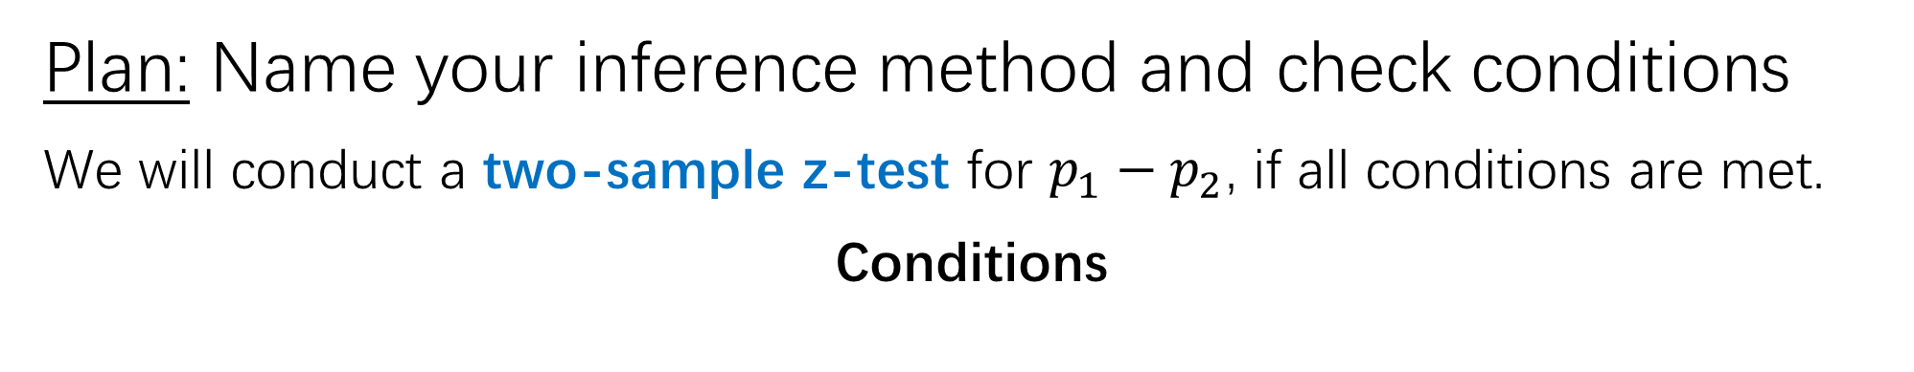
State-Plan-Do-Conclude
Plan: Name your inference method and check conditions
We will conduct a two-sample z-test for $p_{1}−p_{2}$, if all conditions are met.
Conditions

Slide 17
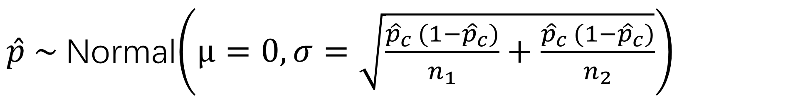
Recall: Why we check conditions
$\hat{p} \sim$Normal$\left(μ=0, σ=\sqrt{\frac{{\hat{p}}_{c} (1−{\hat{p}}_{c})}{n_{1}}+\frac{{\hat{p}}_{c} (1−{\hat{p}}_{c})}{n_{2}}}\right)$
2) 10% condition
→ calculable spread
3) Large counts
→ approx. normal
shape
1) Random condition
→ unbiased center

Slide 18

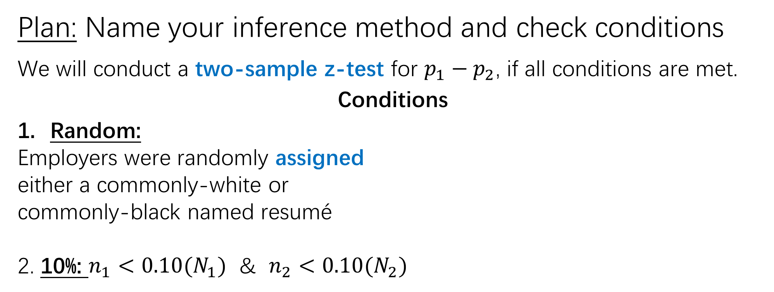


State-Plan-Do-Conclude
Plan: Name your inference method and check conditions
We will conduct a two-sample z-test for $p_{1}−p_{2}$, if all conditions are met.
Conditions
Random:
Employers were randomly assigned
either a commonly-white or
commonly-black named resumé
2. 10%: $n_{1}<0.10(N_{1})$ & $n_{2}<0.10(N_{2})$
3. Large Counts:
$$n_{1}{\hat{p}}_{c}≥10$$
$$n_{1}(1−{\hat{p}}_{c})≥10$$
$$n_{2}{\hat{p}}_{c}≥10$$
$$n_{2}(1−{\hat{p}}_{c})≥10$$
Only have to do 10% when sampling. However, this is an experiment. We don’t have to check this condition!

Slide 19
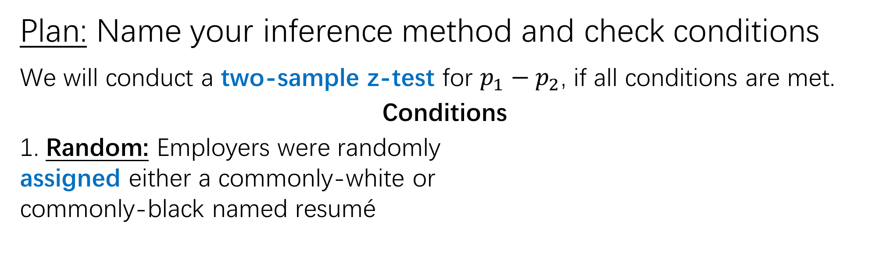


State-Plan-Do-Conclude
Plan: Name your inference method and check conditions
We will conduct a two-sample z-test for $p_{1}−p_{2}$, if all conditions are met.
Conditions
1. Random: Employers were randomly
assigned either a commonly-white or
commonly-black named resumé
2. Large Counts:
$$n_{1}{\hat{p}}_{c}≥10$$
$$\left(2445\right)(.084) ≥10$$
$$n_{1}(1−{\hat{p}}_{c})≥10$$
$$\left(2445\right)(1−.084) ≥10$$
$$n_{2}{\hat{p}}_{c}≥10$$
$$\left(2445\right)(.084) ≥10$$
$$n_{2}(1−{\hat{p}}_{c})≥10$$
$$\left(2445\right)(1−.084) ≥10$$

Slide 20



State-Plan-Do-Conclude
Plan: Name your inference method and check conditions
We will conduct a two-sample z-test for $p_{1}−p_{2}$, if all conditions are met.
Conditions
1. Random: Employers were randomly
assigned either a commonly-white or
commonly-black named resumé
2. Large Counts:
$$n_{1}{\hat{p}}_{c}≥10$$
$$205.4≥10$$
$$n_{1}(1−{\hat{p}}_{c})≥10$$
$$2239.6≥10$$
$$n_{2}{\hat{p}}_{c}≥10$$
$$205.4≥10$$
$$n_{2}(1−{\hat{p}}_{c})≥10$$
$$2239.6≥10$$

Slide 21
State-Plan-Do-Conclude
Do: Perform calculations (if conditions met), report the test statistic and the p-value
z = 4.231
p-value = 0.00001

Slide 22
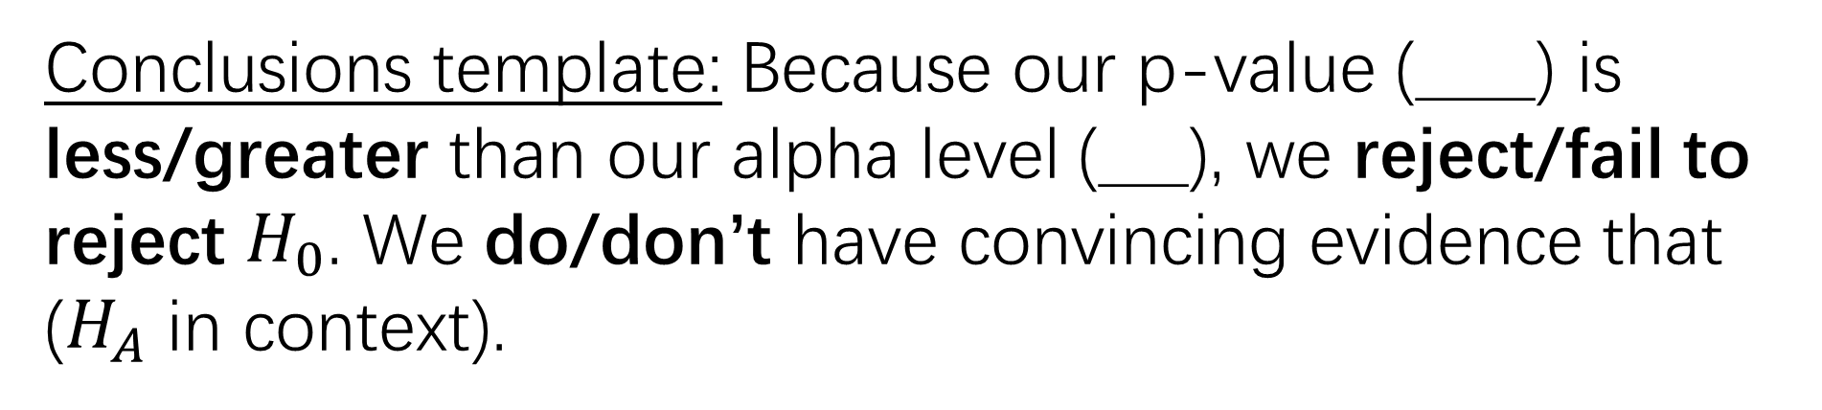
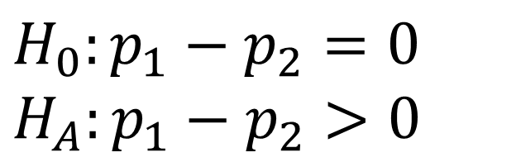
State-Plan-Do-Conclude
Conclude: Reject or fail to reject $H_{0}$ and justify
$$H_{0}:p_{1}−p_{2}=0$$
$$H_{A}:p_{1}−p_{2}>0$$
z = 4.231
p-value = 0.00001
α = 0.05
Conclusions template: Because our p-value (____) is less/greater than our alpha level (___), we reject/fail to reject $H_{0}$. We do/don’t have convincing evidence that ($H_{A}$ in context).

Slide 23
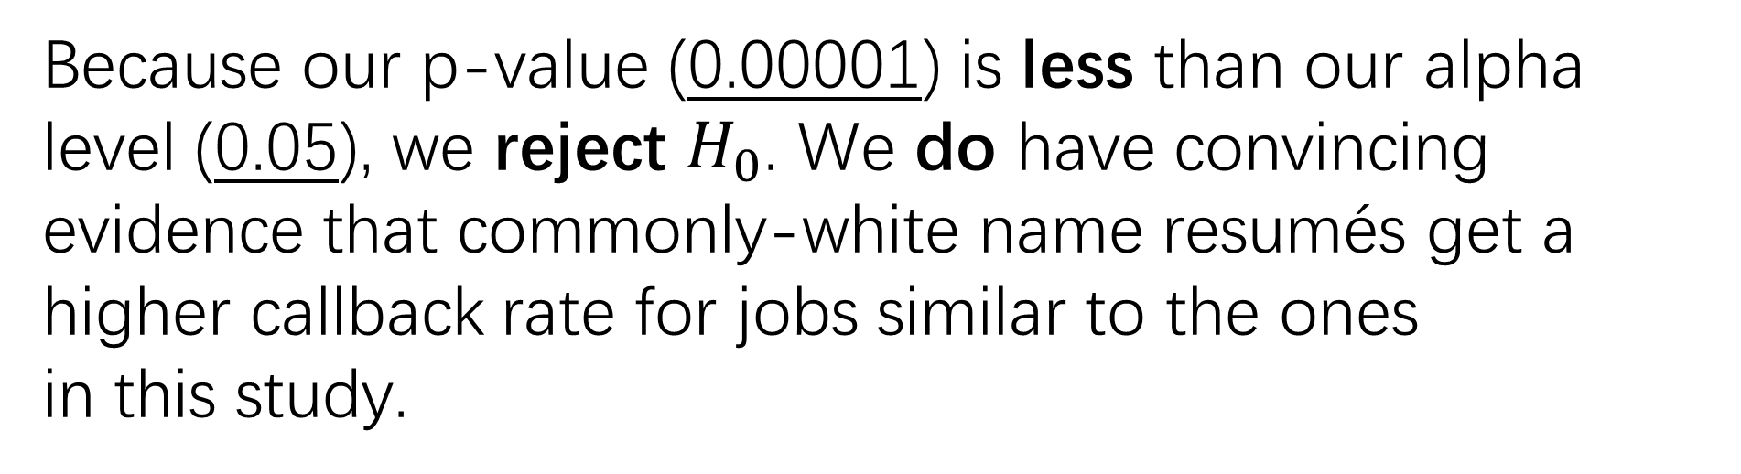
State-Plan-Do-Conclude
Conclude: Reject or fail to reject $H_{0}$ and justify
$$H_{0}:p_{1}−p_{2}=0$$
$$H_{A}:p_{1}−p_{2}>0$$
z = 4.231
p-value = 0.00001
α = 0.05
Because our p-value (0.00001) is less than our alpha level (0.05), we reject $H_{0}$. We do have convincing evidence that commonly-white name resumés get a higher callback rate for jobs similar to the ones
in this study.

